Slide 1
GUI Programming with Kivy
Building Graphical User Interfaces with the Kivy toolkit
Demos: https://github.com/CP1404/KivyDemos

Slide 2
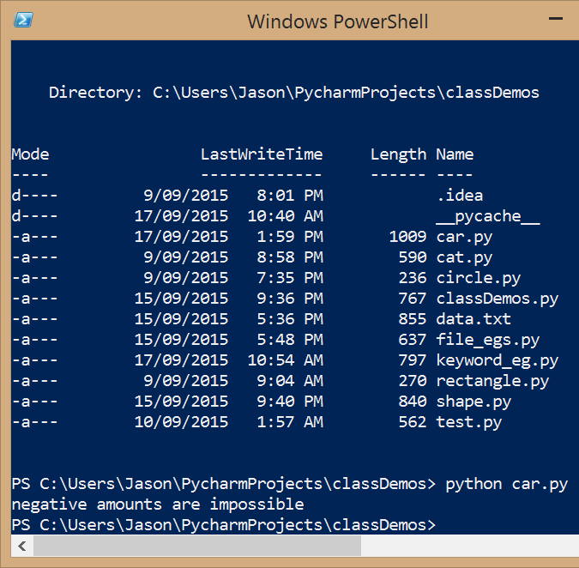
All of the programs we have made so far are command-line only!
Information flows into a program via keyboard input, file input, or random numbers
Information flows out of a program via the console screen, or file output
Notes:
There is another way to get input - using command-line parameters: https://docs.python.org/3.4/library/argparse.html

Slide 3
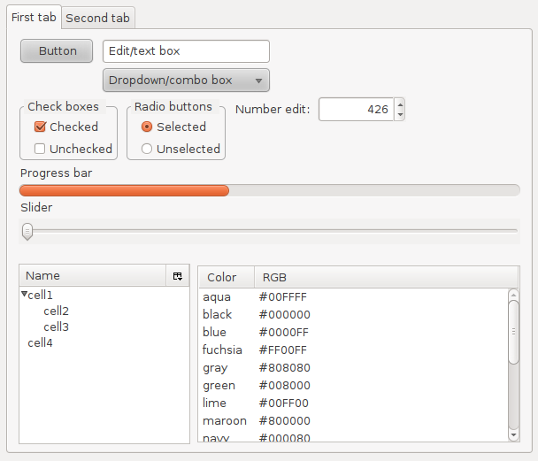
But modern computers support far more meaningful human-computer interaction
Modern operating systems have a Graphical User Interface
The GUI allows a user to interact with a program via “widgets” - visual indicators and controls
Notes:
https://en.wikipedia.org/wiki/Widget_(GUI)
"Widgets" by MarkEchidna at the English language Wikipedia. Licensed under CC BY-SA 3.0 via Commons - https://commons.wikimedia.org/wiki/File:Widgets.png#/media/File:Widgets.png

Slide 4

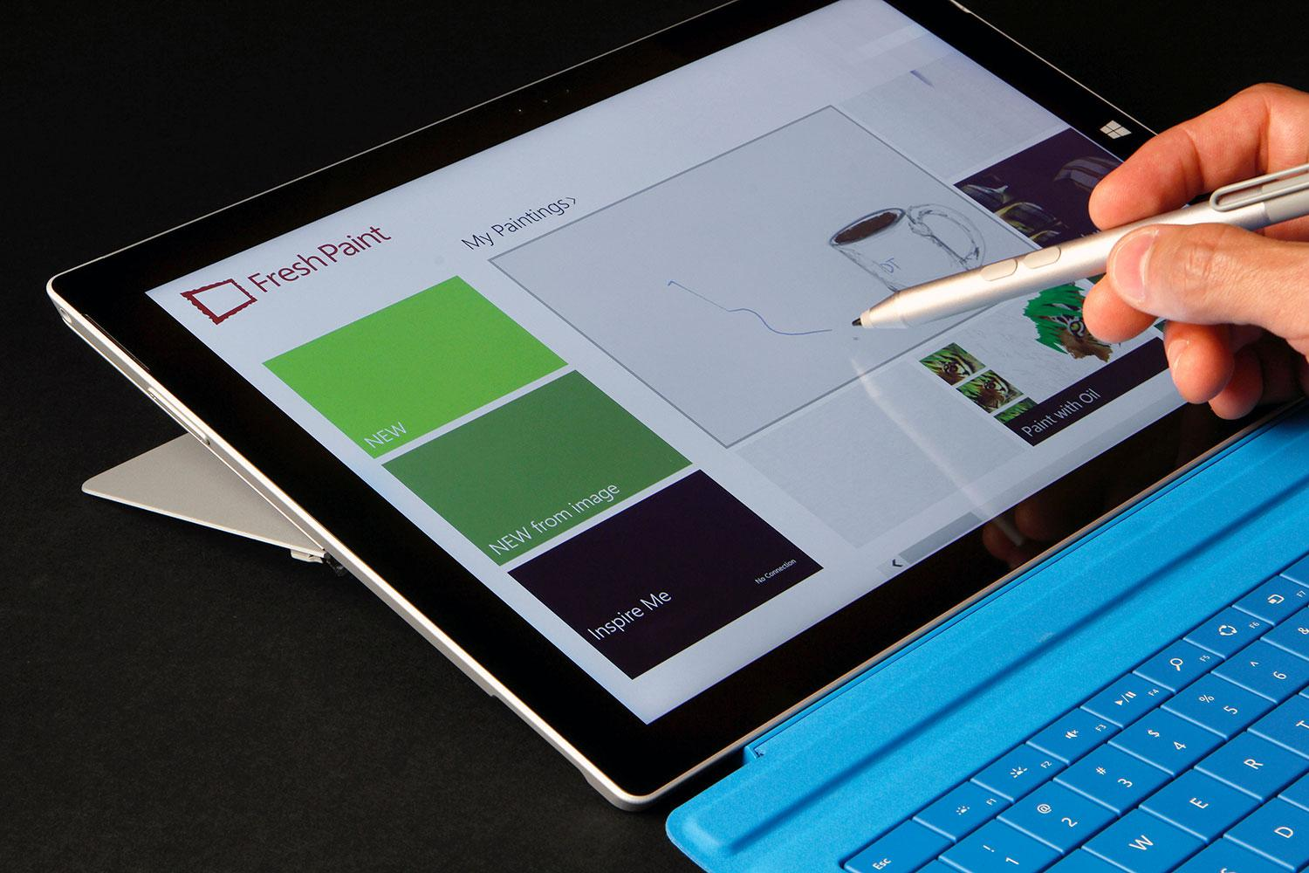
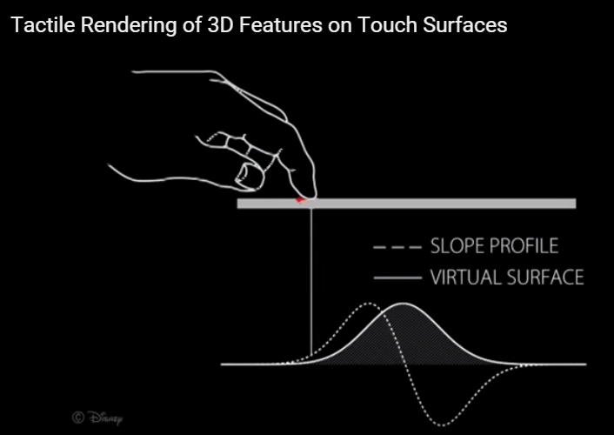
A GUI program supports many forms of interaction
E.g. mouse, keyboard, screen, controllers, ...
The newest ways are the most human:
Touch input, finger and hand input, haptic feedback
We now also use the term NUI - Natural UI
Notes:
http://www.microsoft.com/surface/en-au
https://www.leapmotion.com/
https://www.youtube.com/watch?t=43&v=zo1n5CyCKr0

Slide 5

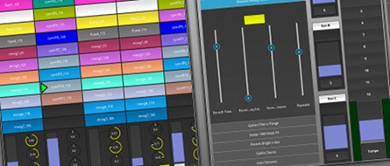
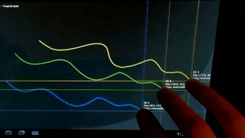
So how does Python support GUIs?
A number of different GUI frameworks exist:
Tkinter (built into Python)
wxWidgets
SDL
many more…
We will learn a modern GUI called Kivy
Notes:
http://kivy.org/#gallery

Slide 6
Kivy is a GUI toolkit - a collection of modules that contain related classes
A Kivy program consists of GUI objects - special objects that can be seen on the screen that are created from Kivy classes
In GUI terminology they are known as widgets
The coding pattern for a Kivy program is:
Import the necessary Kivy module(s)
Use Kivy classes to create widgets
Write Python code to handle interaction and program logic
Notes:
In fact, the term “Widget” is very common: https://en.wikipedia.org/wiki/Widget_(GUI)
https://en.wikipedia.org/wiki/Widget_toolkit

Slide 7
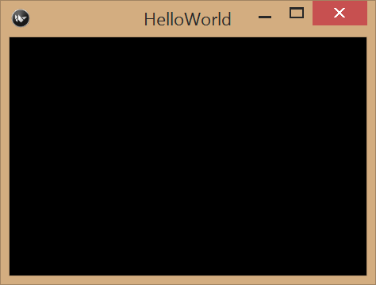
Example: “Hello World” in Kivy
from kivy.app import App
from kivy.app import Widget
class HelloWorld(App):
def build(self):
self.root = Widget()
return self.root
HelloWorld().run()

Slide 8
First, we import a few Kivy modules
from kivy.app import App
from kivy.app import Widget
class HelloWorld(App):
def build(self):
self.root = Widget()
return self.root
HelloWorld().run()
Giving us access to Kivy classes App and Widget
Here, “kivy.” denotes a Python package
A package is a collection of related modules
Both App and Widget are within the app module
Notes:
https://docs.python.org/2/tutorial/modules.html#packages
Each package in Python is a directory which MUST contain a special file called __init__.py

Slide 9
Next, we define a derived App class
from kivy.app import App
from kivy.app import Widget
class HelloWorld(App):
def build(self):
self.root = Widget()
return self.root
HelloWorld().run()
The class overrides App.build() to return an empty Widget instance
self.root comes from the App class, it refers to the main widget of our Kivy program
All other widgets get added to the main widget

Slide 10
Lastly, we create an instance of our derived App class
from kivy.app import App
from kivy.app import Widget
class HelloWorld(App):
def build(self):
self.root = Widget()
return self.root
HelloWorld().run()
We call App.run() on this (anonymous) instance
That’s how Kivy knows to make the GUI program visible
Kivy uses the widget returned by build()
Notes:
If you don’t called run() your GUI window will not appear!

Slide 11
Wait... class? instance? self? What?
We have decided to put Kivy before classes in this subject as we know past students wanted more time to learn and practise Kivy, especially for the last assignment
But... Kivy uses classes and objects (instances). We only need to understand enough for now to be able to use Kivy.
So, here's a "quick start" into object oriented programming with classes, focusing on Kivy. We'll get into more detail later.

Slide 12
The bits (names)
new class is a specialised version of Kivy's App class
from kivy.app import App from kivy.app import Widget
class HelloWorld(App):
def build(self):
self.root = Widget()
return self.root
HelloWorld().run()
Class (new type)
Method (function)
reference to this instance
create new object of type HelloWorld
call method "run" of new object (Kivy defines this method)

Slide 13
For now, we need to know...
When you create a Kivy program, you create your own new class that inherits from App (a class provided by Kivy)
This means your new class "is an" App and automatically includes all of the methods and features that App has, including methods like run().
You write your functions inside the class (indented).
These are called methods.
Every method has a variable called self, which refers to the current object/instance.
When you want to create or access a variable that your app should know about in multiple functions, use self.variable

Slide 14
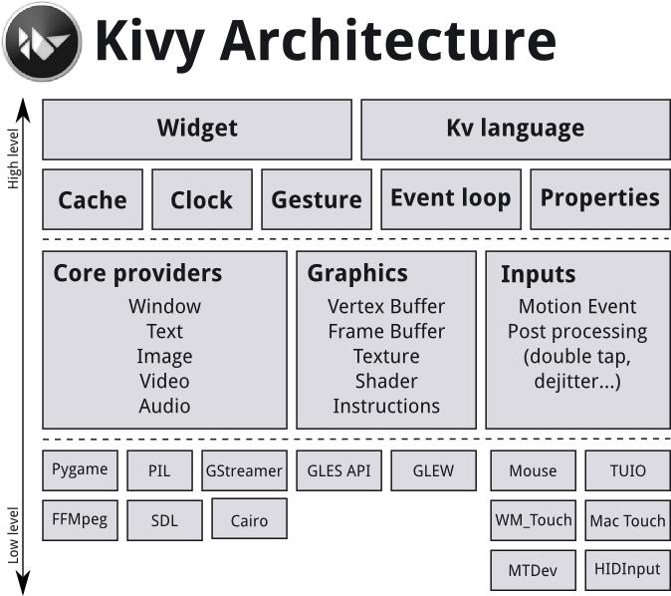
The Kivy Toolkit is massive!
Note: We focus on some of the high-level parts:
Widgets, Kv Language, Properties

Slide 15
The Kv language is how we describe the layout of widgets in a Kivy program
That’s right, we don’t actually write Python code!
This is a common feature of modern GUI toolkits
The Kv language is declarative - we use it to describe what the layout is, not how it is created
What’s so good about this? It supports separation of concerns
The Python code focuses on application logic and behaviour
The Kv code focuses on GUI layout
Note: this doesn’t stop us “programmatically” defining widgets
Notes:
Other toolkits that are similar are: Android, iOS, .NET, and HTML/JS

Slide 16
“Hello Kv” - Python code for the program
from kivy.app import App
from kivy.lang import Builder
class HelloKv(App):
def build(self):
self.title = "Hello world!"
self.root = Builder.load_file('widget.kv')
return self.root
HelloKv().run()
A different import brings Builder into scope instead of Widget
The title of the main window is set using self.title
Builder.load_file() is used to read Kv code from a Kv file
load_file() returns the Widget instance

Slide 17

“Hello Kv” - Kv code for the program
Widget:
That’s it! We only need to write the class name
When run() is called, Kivy calls build() and load_file() loads this Kv code and returns a Widget object
This produces an empty window with a custom title

Slide 18
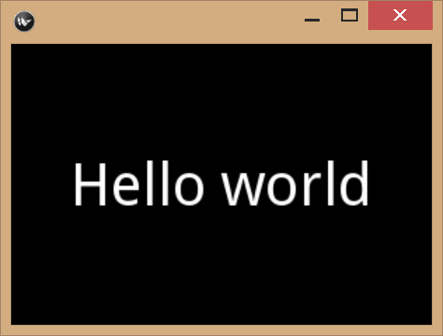
The Kv language uses similar syntactic conventions found in Python
Indentation means something is within something else
For example, a Kv file with this code:
Label:
text: "Hello world"
font_size: 42
Produces:
This Kv code creates a Label object with its text field set as "Hello world" and its font size set to 42 pixels

Slide 19
The Kv language includes special layout widgets for controlling widget position
GridLayout - widgets within it are positioned in a grid (rows and columns)
BoxLayout - widgets within it are positioned in a single line (horizontal or vertical)
AnchorLayout - widgets within it are positioned relative to its edges (top, bottom, left, right) or its centre
and many more… (we focus on these 3 only)

Slide 20
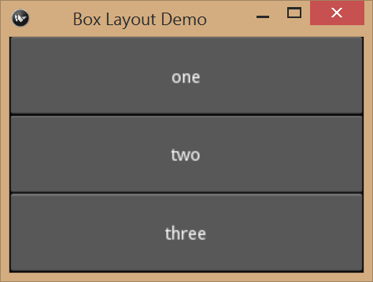
Example: a vertical BoxLayout containing three Buttons
BoxLayout:
orientation: 'vertical'
Button:
text: 'one'
Button:
text: 'two'
Button:
text: 'three'

Slide 21
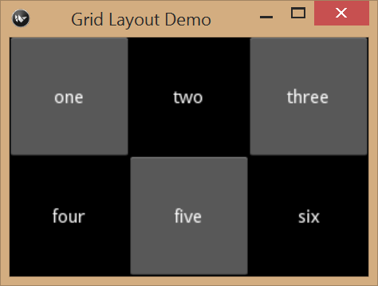
Example: a 2x3 GridLayout containing three Buttons and three Labels
GridLayout:
rows: 2
cols: 3
Button:
text: 'one'
Label:
text: 'two'
Button:
text: 'three'
Label:
text: 'four'
Button:
text: 'five'
Label:
text: 'six'
Notes:
Please note: it is enough to specify either the rows value or cols value. Although it’s better to clearly specify both!

Slide 22
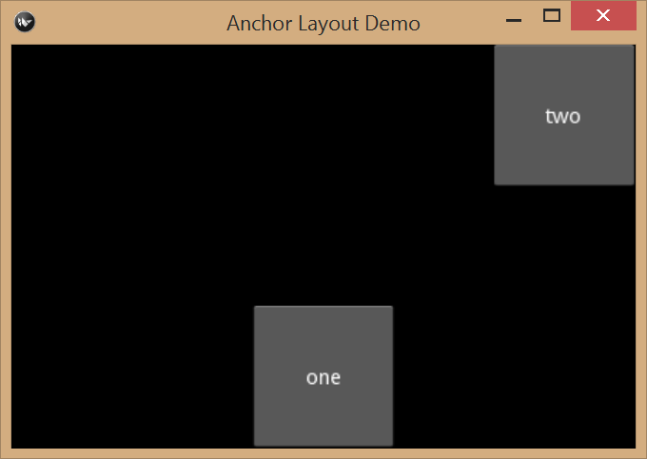
Example: an AnchorLayout with two Buttons anchored at different places
AnchorLayout:
AnchorLayout:
anchor_x: 'center'
anchor_y: 'bottom'
Button:
size_hint: None, None
size: 100, 100
text: 'one'
AnchorLayout:
anchor_x: 'right'
anchor_y: 'top'
Button:
size_hint: None, None
size: 100, 100
text: 'two'
Notes:
Notice that we placed each Button widget within its own AnchorLayout widget...

Slide 23
Layouts are further controlled by using layout hints
size_hint indicates to Kivy the sizing method for a widget
E.g. this Label is sized automatically to fill 100% of available space
Label:
text: "Kivy"
size_hint: 1, 1
E.g. this Button is sized based on its specific width, but its height is still automatically filling 100% of available space
Button:
text: "OK"
size_hint_x: None
width: 100
Notes:
Note the meaning of the layout hints changes depending on which layout widget they are used within. For more examples, see: http://kivy.org/docs/guide/widgets.html#organize-with-layouts

Slide 24
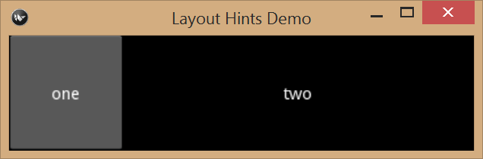
Example: a BoxLayout containing a Button with a fixed width of 100 pixels
BoxLayout:
orientation: 'horizontal'
Button:
size_hint_x: None
width: 100
text: 'one'
Label:
size_hint: 1, 1
text: 'two'

Slide 25
To control the position of text within a Label we specify text alignment
E.g. this Label displays its text left justified with a relative height filling 10% of the available space
Label:
text: "This is useful..."
text_size: self.size
halign: 'left'
size_hint_y: 0.1
Note: the size of the text within the Label is independent from the size of the Label widget
We used text_size to make the text size the same as the label

Slide 26
The Kv language has three special keywords for referring to different things
self - refers to the “current” widget
app - refers to the Python App class
root - refers to the top-level widget that contains everything else
Label:
text: "This is useful..."
text_size: self.size
halign: 'left'
size_hint_y: 0.1

Slide 27
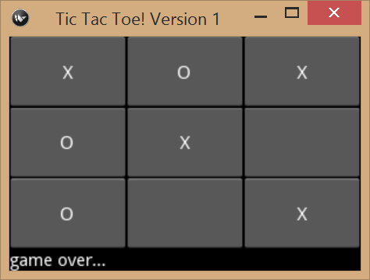
game_v1.py
A complete example of GUI layout in Kivy using layout widgets, layout hints, a label widget and some button widgets
https://github.com/CP1404/KivyDemos
Notes:
https://github.com/CP1404/KivyDemos

Slide 28
Summary of the Kv language (so far)
The root widget is first - typically it’s one of the layout widgets
E.g. BoxLayout
Indenting is how we add widgets inside a layout widget
Widgets have attributes (text, font_size, …), also indented
Each widget has common attributes and specific attributes (size_hint, width, halign, ...)

Slide 29
When the user clicks on a Button widget, Kivy generates a Button event
Like all GUI toolkits, Kivy supports event-driven programming
Kivy allows you to handle the button event by creating a method in your App class (we call this method a callback)
We associate the button with our callback by using a Button attribute called on_press
Actually, various Kivy widgets support different events:
Mouse events, Button events, Text events, …
They are handled by using the appropriate attribute
Notes:
https://en.wikipedia.org/wiki/Event-driven_programming
http://kivy.org/docs/guide/lang.html#event-bindings

Slide 30
Button Event Example
from kivy.app import App
from kivy.lang import Builder
class ButtonEventDemo(App):
def build(self):
self.title = "Button Event Demo"
self.root = Builder.load_file('button_event.kv')
return self.root
def button_pressed(self):
print("ouch!")
ButtonEventDemo().run()
# Kv code
BoxLayout:
Button:
text: "Press me"
on_press: app.button_pressed()
Notes:
Recall that app is a special keyword in Kv code for referring to the App object

Slide 31
Variation - using Kv self allows you to send a parameter(s) to a callback!
from kivy.app import App
from kivy.lang import Builder
class ButtonEventDemo(App):
def build(self):
self.title = "Button Event Demo"
self.root = Builder.load_file('button_event.kv')
return self.root
def button_pressed(self, button):
print('app: ' + self) # this is the app object
print(str(button) + ' says "ouch!"')
ButtonEventDemo().run()
BoxLayout:
Button:
text: "Press me"
on_press: app.button_pressed(self)

Slide 32
Another variation - you can define the id attribute for a widget
BoxLayout:
orientation: 'vertical'
Button:
text: "Press me"
on_press: app.handle_pressed()
Label:
id: my_label
text: "Hello world"
font_size: 42

Slide 33
This allows you to access a widget from Python using self.root.ids
from kivy.app import App
from kivy.lang import Builder
import random
class IDDemo(App):
def build(self):
self.title = "Demoing the id attribute"
self.root = Builder.load_file('id_demo.kv')
return self.root
def handle_pressed(self):
if random.randint(1, 10) <= 5:
self.root.ids.my_label.text = "ouch!!"
else:
self.root.ids.my_label.text = "stop that!!"
app = IDDemo()
app.run()

Slide 34

Kivy uses a best-practice design strategy called Model-View-Controller (MVC)
The App class is the “controller” - it’s in charge of program behaviour
The Kv code is the “view” - it’s what the program looks like
What’s the “model”?
Data/state of the App
Special Kivy class variables added to your App class
They are called Properties
Notes:
This is a particular type of object-oriented design: where we group related objects as “view” or “model” or “controller”. The model stores the information for the app, the controller looks after the app’s behaviour, the view presents the model’s information to the user as GUI widgets

Slide 35
Example - adding a StringProperty class variable
from kivy.app import App
from kivy.lang import Builder
from kivy.app import StringProperty
class MVCDemo(App):
message = StringProperty()
def build(self):
self.title = "Simple MVC Demo"
self.root = Builder.load_file('mvc.kv')
return self.root
def handle_press(self):
self.message = self.root.ids.user_input.text
MVCDemo().run()

Slide 36
Note: self.message is generated by Kivy from the class variable MVCDemo.message
class MVCDemo(App):
message = StringProperty()
def build(self):
self.title = "Simple MVC Demo"
self.root = Builder.load_file('mvc.kv')
return self.root
def handle_press(self):
self.message = self.root.ids.user_input.text
Note: this will happen whenever you assign a Kivy property to a class variable

Slide 37
And here is how we access the “model” from the “view”
BoxLayout:
Label:
text: app.message
font_size: 42
TextInput:
id: user_input
multiline: False
on_text_validate: app.handle_press()

Slide 38
When self.message changes in Python, the Label text is updated in the kv code
BoxLayout:
Label:
text: app.message
font_size: 42
TextInput:
id: user_input
multiline: False
on_text_validate: app.handle_press()
This is called the “observer pattern”
The Label is observing changes to app’s message

Slide 39
There are a variety of property types that can be used with class variables in Kivy
StringProperty - an observed string
NumericProperty - an observed number
ObjectProperty - an arbitrary observed object
ListProperty - an observed list of items
… many more, but in CP1404 we focus on StringProperty
Note: a default value can be provided when creating the property
Now, let’s see all of these aspects of Kivy in a single example...

Slide 40
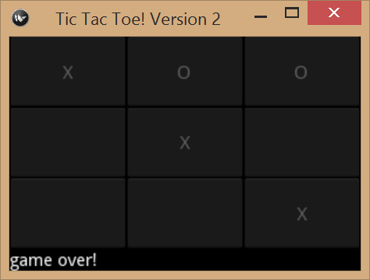
game_v2.py
A complete GUI program in Kivy using callbacks, MVC, and the observer pattern
Note: we also created a console “view” for the game “model” called “play_game_console.py” (the model is reusable!)

Slide 41
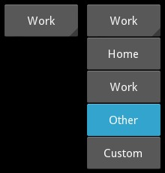
Kivy “Spinner” - drop-down list
https://github.com/CP1404/KivyDemos/blob/master/spinner_demo.py and https://github.com/CP1404/KivyDemos/blob/master/spinner_demo.kv
Spinner is a widget that provides a quick way to select one value from a set
Spinner has a values property, which is a list
Use the on_text event to set a callback for when the text changes, which is when the user changes the selection
The on_release event might also be useful, but this fires before the text has changed

Slide 42
Popups
https://github.com/CP1404/KivyDemos/blob/master/popup_demo.py and https://github.com/CP1404/KivyDemos/blob/master/popup_demo.kv
Kivy has a feature to create popups (not like separate floating windows, but effectively on top)
You create the popup, then hide it and open() or dismiss() it when you want
Popup: id: popup title: "Add Item" BoxLayout: …

Slide 43
Creating widgets with Python
See https://github.com/CP1404/KivyDemos/blob/master/dynamic_widgets.py
If your GUI is static, it’s usually easier to create your widgets in Kv code in a .kv file
If your GUI is dynamic, e.g. based on a file or other input, then you need to create widgets programmatically using Python
In the code below, we create one Button per item in a list, bind a click handler function (press_item) and add the new Button to an existing (layout) widget (with someID).
for item in self.items: temp_button = Button(text=item) temp_button.bind(on_release=self.press_item) self.root.ids.someID.add_widget(temp_button)

Slide 44
QuickSum
https://github.com/CP1404/KivyDemos/blob/master/quick_sum_app.py
https://github.com/CP1404/KivyDemos/blob/master/quick_sum_gui.kv
Jason uses this to quickly and accurately add up marks for various things (exams, assignments, etc.)

Slide 45
QuickSum - things to note:
The use of class rules in the Kv file
e.g. <Button>: applies to all Buttons
The use of canvas.before and canvas.after to change the background colour or other aspects of a widget
The use of alternative fonts and button images
Using the children property of a widget allows you to access the widgets added inside
The use of Window.size to control the window size

Slide 46
Run code at the start/end of a program
Kivy has special event functions for when your program starts and stops
You don’t call these - Kivy does. You just define them if you want custom behaviour (like saving state to a file)
def on_start(self): """ Run when the app starts… """ ...
def on_stop(self): """ Run when the app exits… """ ...

Slide 47
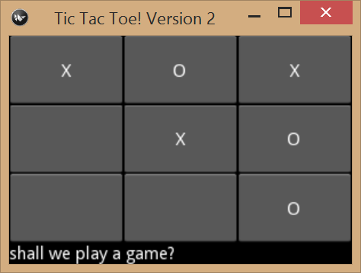
But how are things actually drawn on the screen?
Every Kivy widget object has a canvas attribute
The canvas attribute is a Canvas object
The canvas supports various drawing functionality
E.g. each Button, Label, etc. all have their own canvas attribute that makes them look the way they do...
Notes:
Other GUI toolkits are similar to Kivy… many have a “canvas” that you draw shapes on to...

Slide 48
You make custom 2D drawings using the canvas attribute of a widget
Kivy offers a collection of graphics objects
Rectangle, Ellipse, Line, Color, etc...
You simply add a combination of these objects to a canvas
And then Kivy, its dependencies, and the OS all work together to draw the canvas content on the screen for you...

Slide 49
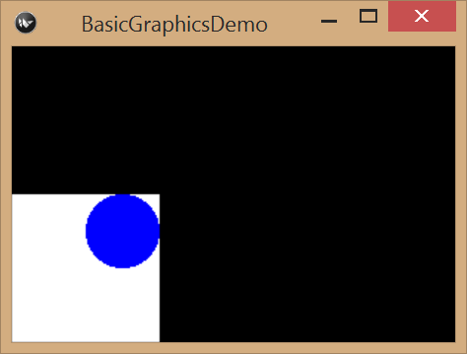
Example - 2D drawing
class BasicGraphicsDemo(App):
def build(self):
self.root = Widget()
# white rectangle 100x100
self.root.canvas.add(Color(1, 1, 1, 1))
self.root.canvas.add(Rectangle(size=(100, 100)))
# blue circle 50x50
self.root.canvas.add(Color(0, 0, 1, 1))
self.root.canvas.add(Ellipse(size=(50, 50), pos=(50, 50)))
return self.root
Notes:
In the Kivy examples online, you will see the use of the with statement - this is syntactic sugar that simplifies adding graphics objects to a widget canvas: http://kivy.org/docs/api-kivy.graphics.html

Slide 50
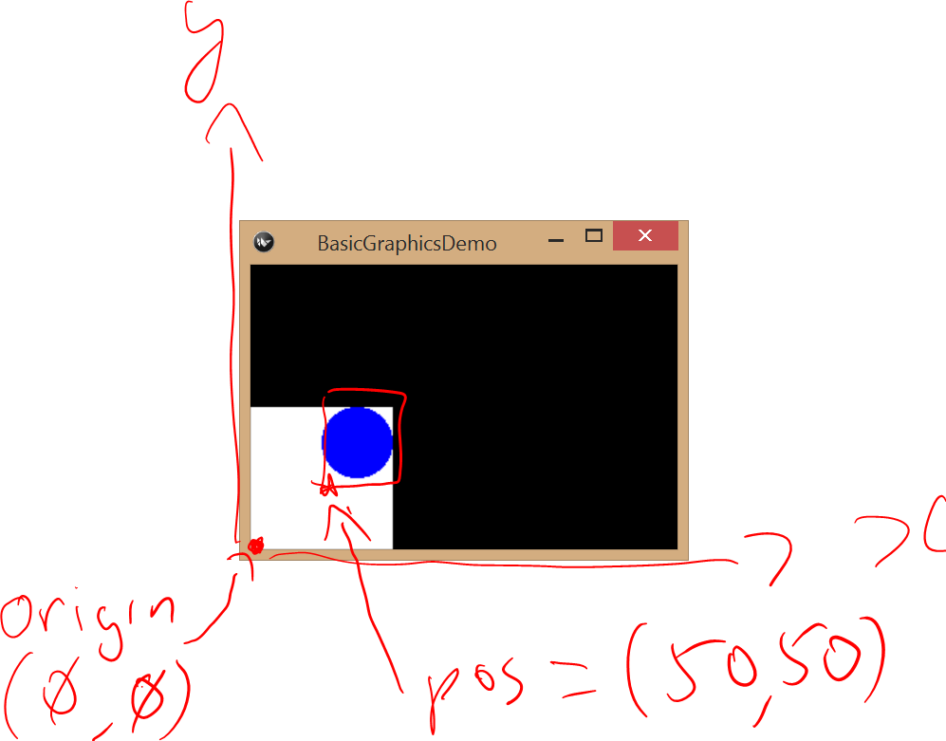
The coordinate system is just like what you remember from school...

Slide 51
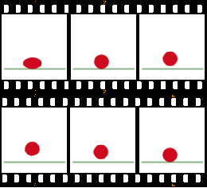
But how do things “move” on screen?
This is done by a process called frame-by-frame animation
The screen is very rapidly redrawn with slight changes which trick your eyes into seeing motion
Notes:
https://en.wikipedia.org/wiki/Animation

Slide 52
Examples from the KivyDemos repo https://github.com/CP1404/KivyDemos
clock_demo
A Clock object and its schedule_interval() method, which allows a callback function to execute on a regular basis
clock_demo2
A GUI with two Buttons and a Label
The Label is updated by scheduled callback function
The Buttons are used to start/stop the regular updates
simple_animation_demo
A callback function is used to move 2D objects on the canvas for a widget - thus giving the illusion of motion

Slide 53
Things to note...
Clock.schedule_interval() has two parameters
The first is the callback function
The second is the interval (in seconds)
The smallest interval possible is determined by the speed of the computer hardware, OS, and middleware
The size and position of 2D objects drawn on any canvas doesn’t respect the layout of its widget
Suggestion: use the root widget’s canvas when custom drawing in Kivy for simplicity
Notes:
It is possible to use any widget’s canvas… but you have to do work to make the 2D objects display relative to the size and position of the widget, see: http://kivy.org/docs/guide/widgets.html#adding-a-background-to-a-layout
Technically, the Clock.schedule_interval() method returns a ClockEvent object...

Slide 54
Summary
Kivy is a powerful GUI toolkit
It allows you to create a GUI program by following the MVC design pattern
It also offers the use of the observer pattern for easily accessing and changing the GUI elements from Python code

Slide 55
Further reading
Kivy setup instructions for CP1404: https://github.com/CP1404/Starter/wiki/Software-Setup
Our demos: https://github.com/CP1404/KivyDemos
Kivy docs:
http://kivy.org/docs/gettingstarted/intro.html
http://kivy.org/docs/api-kivy.uix.widget.html#kivy.uix.widget.Widget
http://kivy.org/docs/guide/widgets.html

